Slide 1

Capstone Presentation
By: Trevor Hicks

Slide 2

Can a video game satisfy your sweet tooth and your need for speed?
"Candy Rush Grand Prix" is a candy-themed go-kart racing game inspired by Mario Kart. Players race through whimsical, sugar-filled environments, navigating tracks made of chocolate, licorice, and other sweets. The game features colorful karts, candy power-ups, and fun, competitive gameplay, perfect for players of all ages.

Slide 3


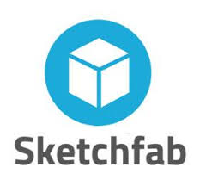


What I used?

Slide 4

What didn’t work?
Passive Fog so players can move threw the clouds and the fog would disperse
GitHub Source Control Setup – at first it wasn’t working to setup but found a work around.
Track Design: track was fairly easy to make and setup but upon testing found track wasn’t connected and later on in development was able to make a fluid seamless track.
Initial problems with the lap counting system, causing laps not to register correctly or inaccurately tracking player progress
Challenges in balancing the power-ups to ensure fair and fun gameplay, as some abilities might have been too powerful or ineffective in early iterations

Slide 5
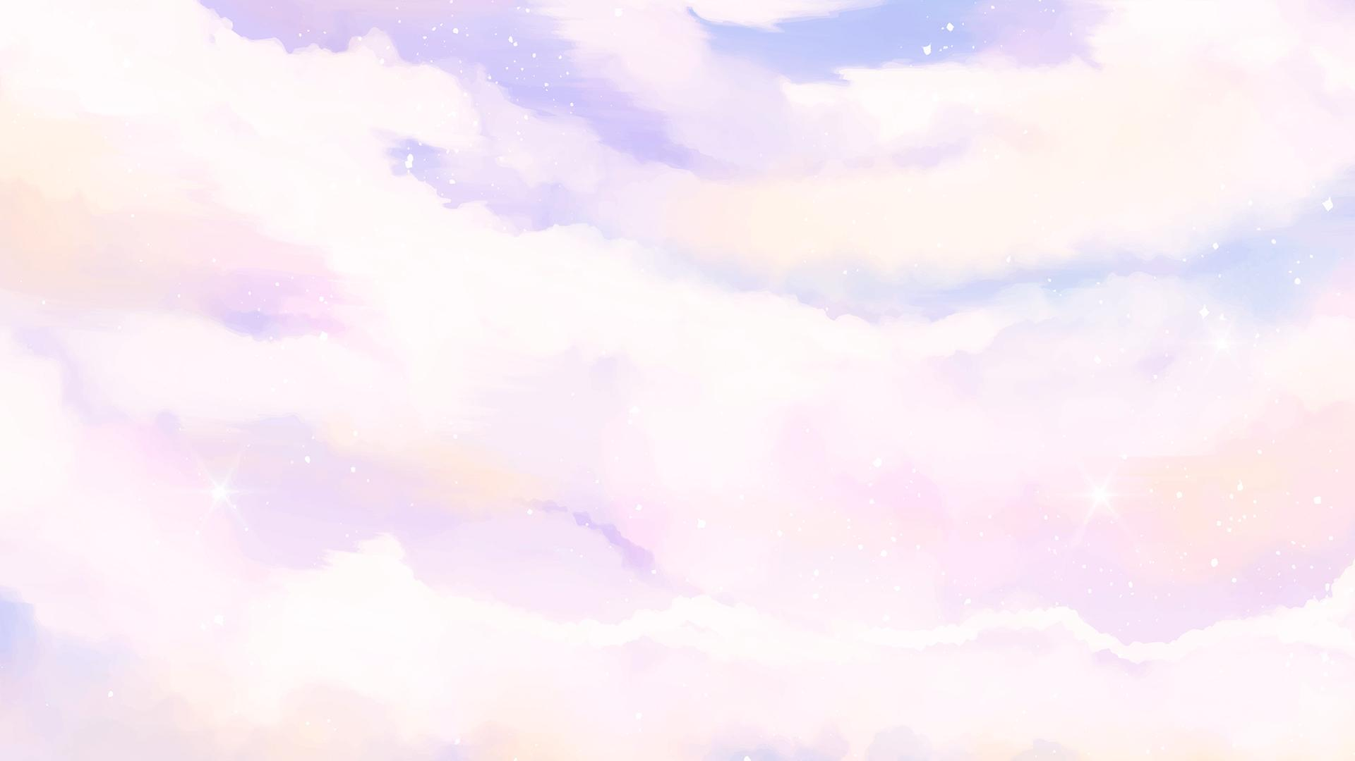
Demo

Slide 6
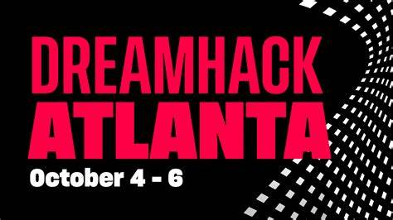
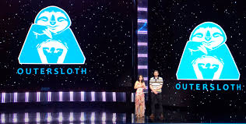
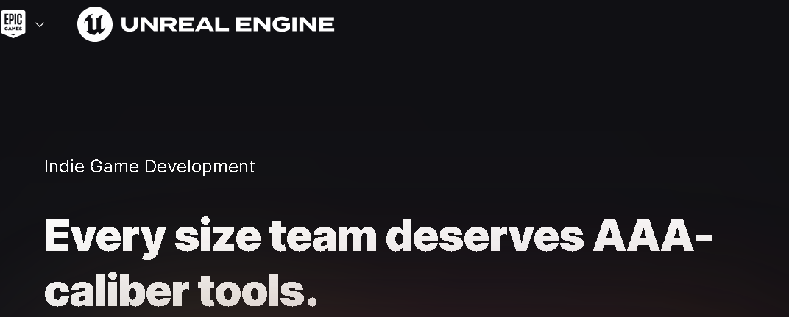
Future Plans
More Items
Bring back Battle Arena’s
Multiplayer / Couch Co-op
More Tracks
More Customization

